Slide 1
OBD-II PIDs
2020.4.25
Sub Han

Slide 2
Contents
Overview
OBD II Connector
PID
CAN bus format
Query
Service
Respond
Application data

Slide 3
Overview
OBD-II PIDs (On-board diagnostics Parameter IDs) are codes used to request data from a vehicle, used as a diagnostic tool.
SAE standard J1979 defines many OBD-II PIDs.
a standardized data link connector defined by SAE J1962.
https://en.wikipedia.org/wiki/OBD-II_PIDs

Slide 4
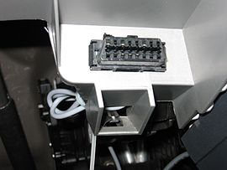
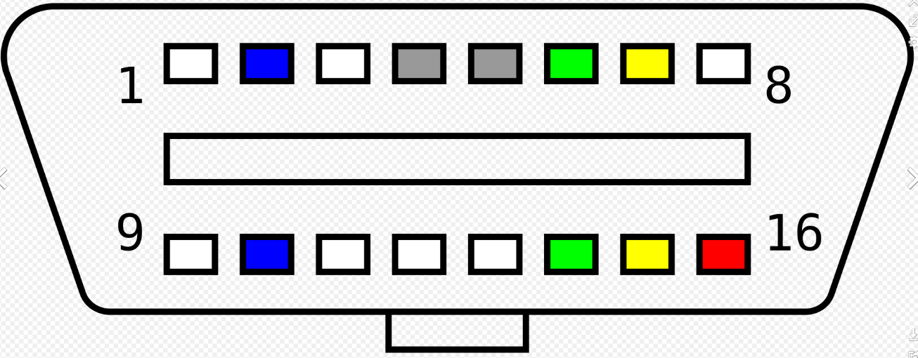
OBD-II Connector
- Pinout
5 : Signal ground
6 : CAN-High (ISO 15765-4 and SAE J2284)
14 : CAN-Low (ISO 15765-4 and SAE J2284)

Slide 5
PID
PID(hex) | PID(dec) | Length(byte) | Description | Units | Fomula
05 | 5 | 1 | Engine coolant temperature | °C | A-40
0C | 12 | 2 | Engine RPM | rpm | (256A+B)/4
0D | 13 | 1 | Vehicle speed | km/h | A
2F | 47 | 1 | Fuel Tank Level Input | % | (100/255)A
A6 | 166 | 4 | Odometer | km | A
https://en.wikipedia.org/wiki/OBD-II_PIDs

Slide 6
CAN (11-bit) bus format
The PID query and response occurs on the vehicle's CAN bus.
The diagnostic reader initiates a query using CAN ID 7DFh, which acts as a broadcast address, and accepts responses from any ID in the range 7E8h to 7EFh. ECUs that can respond to OBD queries listen both to the functional broadcast ID of 7DFh and one assigned ID in the range 7E0h to 7E7h. Their response has an ID of their assigned ID plus 8 e.g. 7E8h through 7EFh.

Slide 7
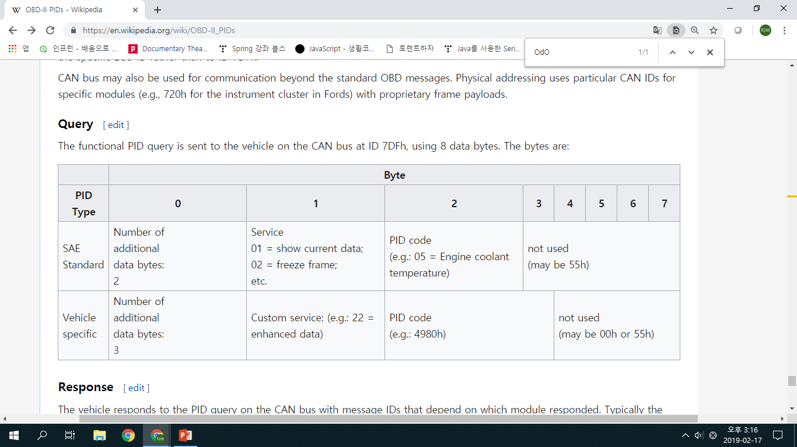
Query
The functional PID query is sent to the vehicle on the CAN bus at ID 7DFh, using 8 data bytes.

Slide 8
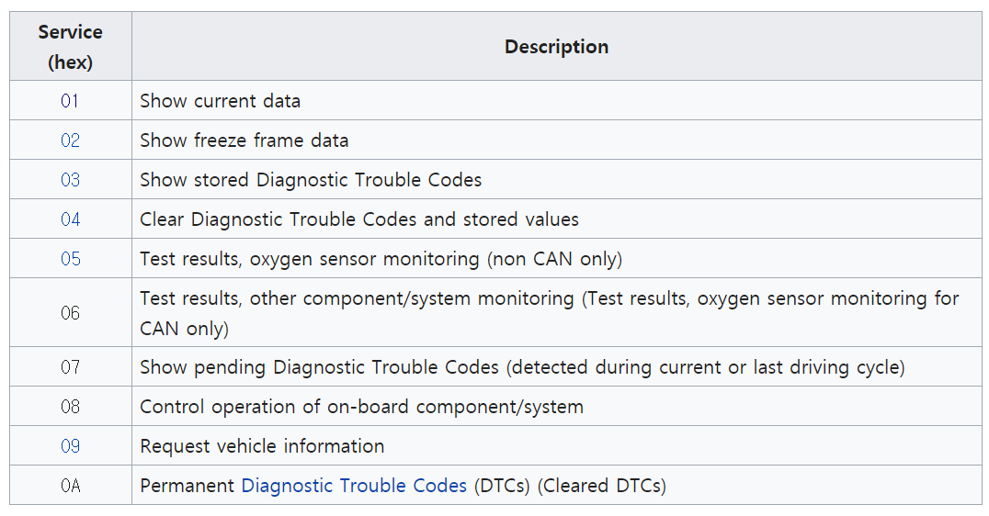
Service
현재 데이터
고장 진단 시 저장된 데이터

Slide 9
Ex) Query Speed
msgID = 7DF ; Transmit message ID (HEX)
msgData = {02010D5555555555} ; Message data (HEX)
0x7DF
02
01
0D
55 55 55 55 55

Slide 10
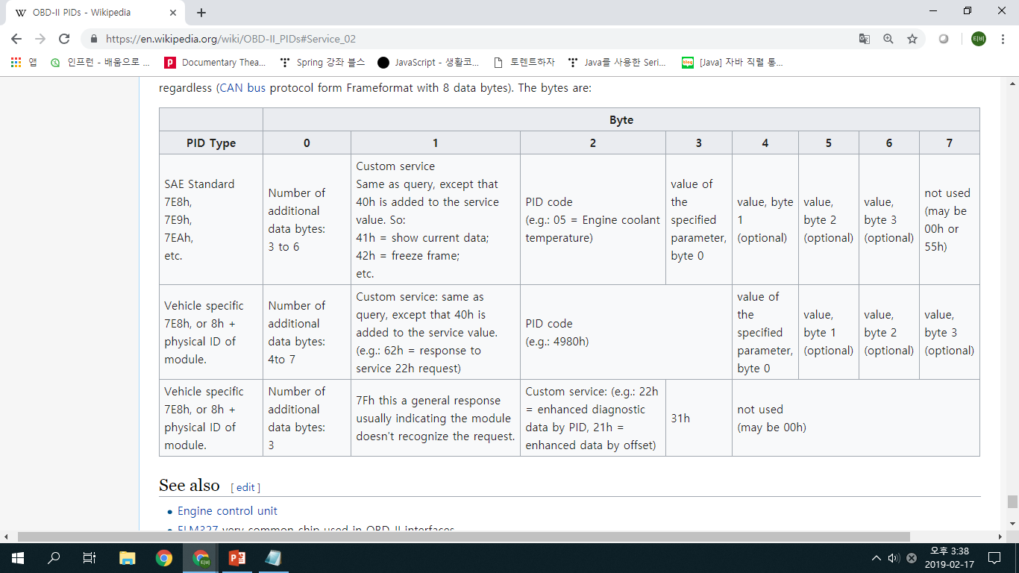
Response
The vehicle responds to the PID query as 8h higher than PID address.

Slide 11
Ex) Respond Speed
msgID = 7E8 ; Transmit message ID (HEX)
msgData = {02010D5555555555} ; Message data (HEX)
0x7E8
03
41
0D
00
aa aa aa aa

Slide 12
Application data
Time stamp; Type; ID;Data
01T195108322;0;7e8;04410c0b75aaaaaa
01T195108331;8;7df;0201115555555555
01T195108336;0;7e8;03411128aaaaaaaa
01T195108353;0;7e8;0341042faaaaaaaa
01T195108351;8;7df;0201045555555555
01T195108371;8;7df;02010f5555555555
01T195108379;0;7e8;03410f38aaaaaaaa
01T195108391;8;7df;02010d5555555555
01T195108397;0;7e8;03410d00aaaaaaaa
01T195108411;8;7df;02010c5555555555
01T195108416;0;7e8;04410c0b82aaaaaa
Time stamp; Type; ID;Data
01T195108431;8;7df;0201115555555555
01T195108436;0;7e8;03411128aaaaaaaa
01T195108453;0;7e8;0341042faaaaaaaa
01T195108451;8;7df;0201045555555555
01T195108472;0;7e8;03410f38aaaaaaaa
01T195108471;8;7df;02010f5555555555
01T195108491;8;7df;02010d5555555555
01T195108497;0;7e8;03410d00aaaaaaaa
01T195108511;8;7df;02010c5555555555
01T195108516;0;7e8;04410c0b8eaaaaaa
01T195108531;8;7df;0201115555555555
https://www.csselectronics.com/screen/page/obd-ii-pid-examples/language/en

